Slide 1
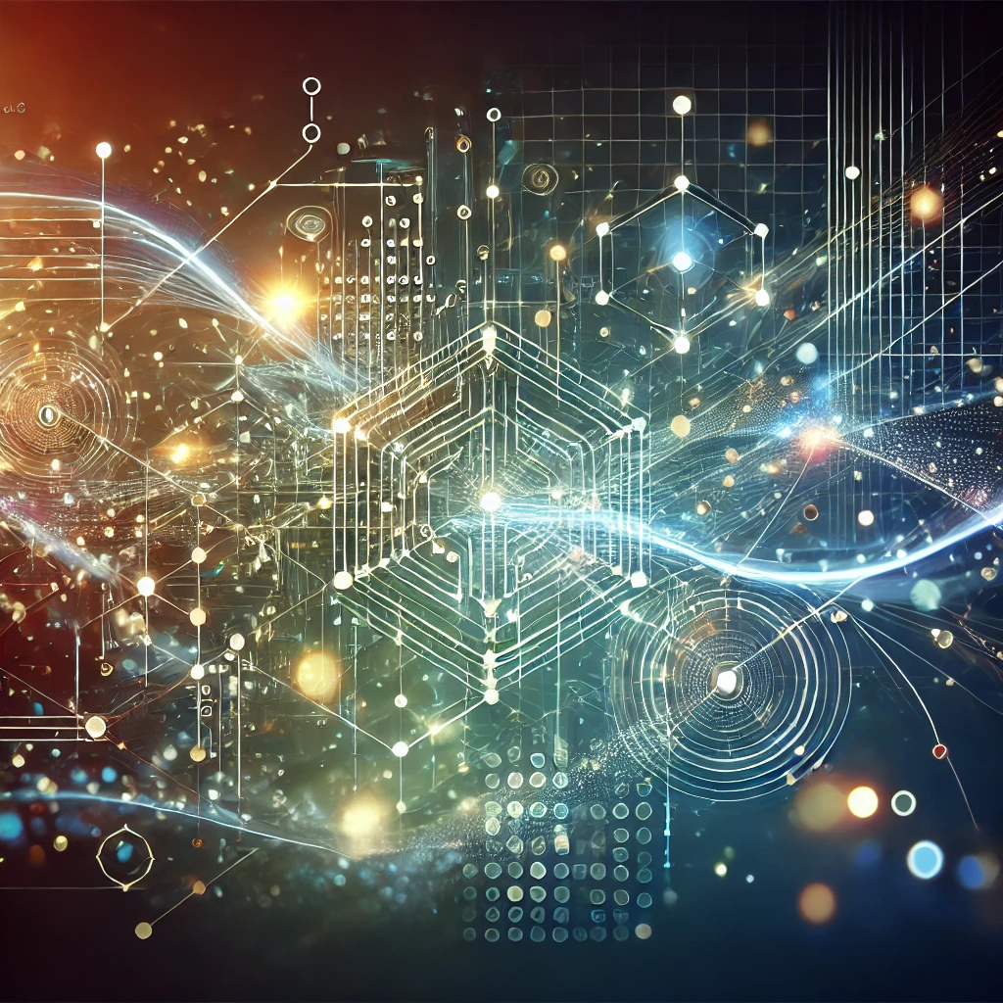
My ITAI1378 Learning Journey
Martin Demel
Department of Science, Technology, Engineering & Math
Houston Community College
ITAI 1378 Computer Vision Patricia McManus December 11th, 2024
GitHub: https://github.com/martindemel/ITAI1378_Computer_Vision_Portfolio

Slide 2
Agenda
Introduction
Journey
A01 - Intro to Computer Vision: Historical Timeline of Computer Vision
L01 - Exploring Real-World Applications of Computer Vision
L03 - Lab ITAI 1378: Jupyter Notebook
A04 - Image Processing Adventure Quest
L05 - Image Classification with SVM
L06 - Chihuahua or Muffin
A06 - TensorFlow Playground Presentation
A07 - ITAI 1378 Manual CNN
L07 - Chihuahua or Muffin with CNN
A09 - ITAI 1378 CV: Object Detection Cheat Sheet
L09 - Object Detection Using Transfer Learning and Pascal VOC 2007 Dataset
Midterm - Object Detection Challenge
Capstone Project - Train an AI Agent to Play Flappy Bird
GitHub
Conclusion
References

Slide 3
Introduction
This presentation represents a structured portfolio of in-depth computer vision and artificial intelligence exploration. Through hands-on personal projects and team collaboration, I have gained practical experience applying techniques such as object detection, image classification, and neural networks.
The course has focused on technical aspects, ethical considerations, and real-world applications of Computer Vision in Artificial intelligence. Each module and assignment depends on my understanding of how computer vision is pivotal in industries like healthcare, security, and autonomous systems.

Slide 4
Journey

Slide 5
A01 Intro to Computer Vision -Historical Timeline of Computer Vision
During our initial assignment, we created a timeline for the significant advancements in computer vision from 2020 to 2024. Our timeline showcased milestones such as the introduction of NVIDIA’s Ampere architecture, YOLOv4 for object detection, and Vision Transformers (ViT). We also examined ethical considerations, such as Fei-Fei Li’s advocacy for AI ethics in healthcare and the European Union’s AI Act. Our collaborative effort deepened our understanding of how computer vision has evolved and its transformative impact across industries.
2024
Vision Transformers updated to process more sophisticated tasks like 3D Scene reconstruction and Object tracking in Videos. (Medium)
Fei-Fei Li continued to advocate for ethical AI with focus on sensitive data and human centered principles. (McKinsey)
Smart Cities improved planning and safety by adopting AI- powered technologies.
AI driven surveillance brought debates over privacy due to advanced capabilities. (Sifi)

Slide 6
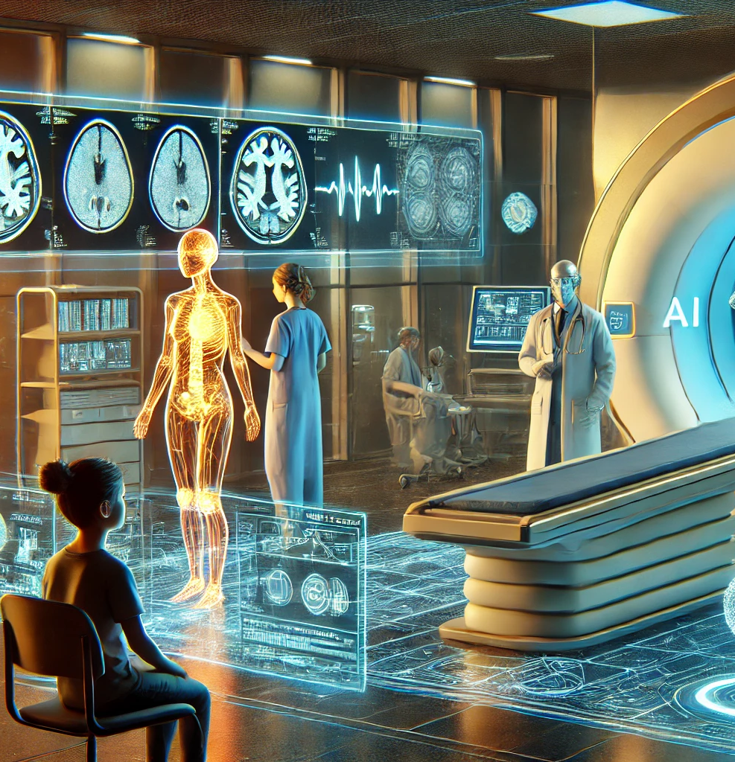
L01Exploring Real-World Applications of Computer Vision
From a young age, I’ve been fascinated by computers and their real-world applications, especially in healthcare. I was inspired by my mom’s work and discussions with my friend Ray, an MRI technician.
This assignment explored how AI and deep learning improve medical image analysis. They enhance diagnostics with faster scans and sharper images, such as reducing MRI scan times from 30 minutes to 10. While advancements offer incredible benefits, challenges like high costs and the “black box” nature of AI remain. I believe this field holds immense promise for early detection and better patient outcomes.

Slide 7
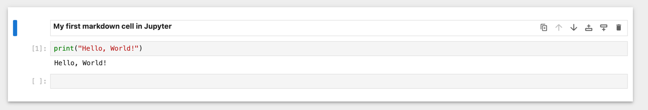
L03 Lab ITAI 1378 – Jupyter Notebook
This lab session refreshed my skills with GitHub and Jupyter Notebook. After recovering access to my GitHub account, I created a new repository, “Jupyter-exploration,” and added a readme file summarizing the lab purpose. In Jupyter Notebook, I created and formatted markdown cells, wrote basic Python code (print("Hello, World!")), and uploaded the notebook to GitHub. While I primarily use Visual Studio Code, I found Jupyter’s focus on data analysis and visualization a valuable tool for future projects.

Slide 8
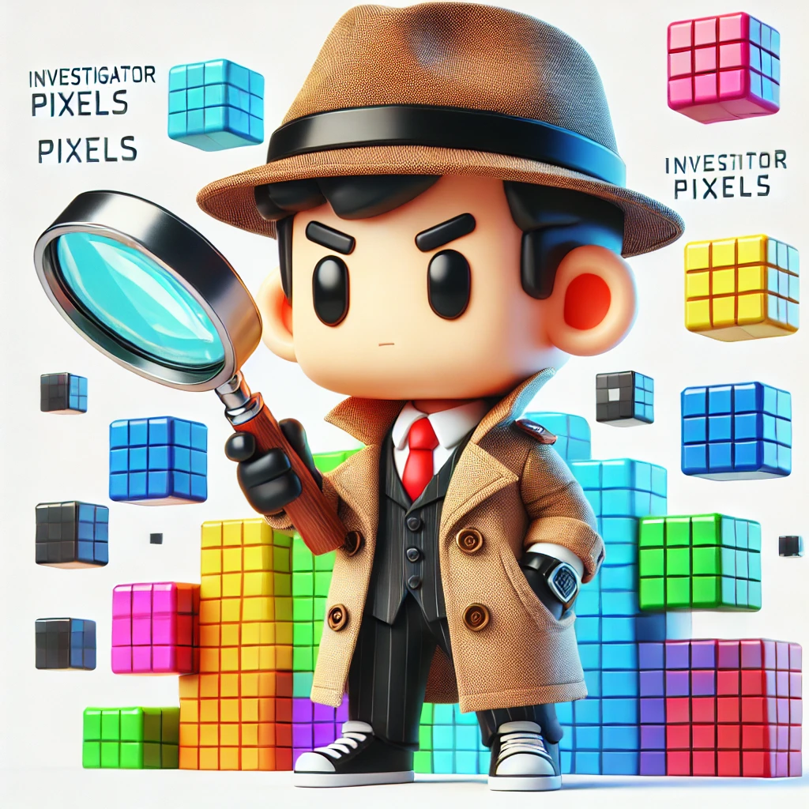
A04 "Image Processing Adventure Quest"
Our team collaborated on a creative project, crafting a narrative titled “Image Processing Adventure Quest” to explore color models and their applications. The story followed Investigator Pixels, who explained the differences between RGB and CMYK models. RGB, an additive model, is used in digital devices, while CMYK, a subtractive model, is associated with printing. We also highlighted other models like HSL and LAB.

Slide 9
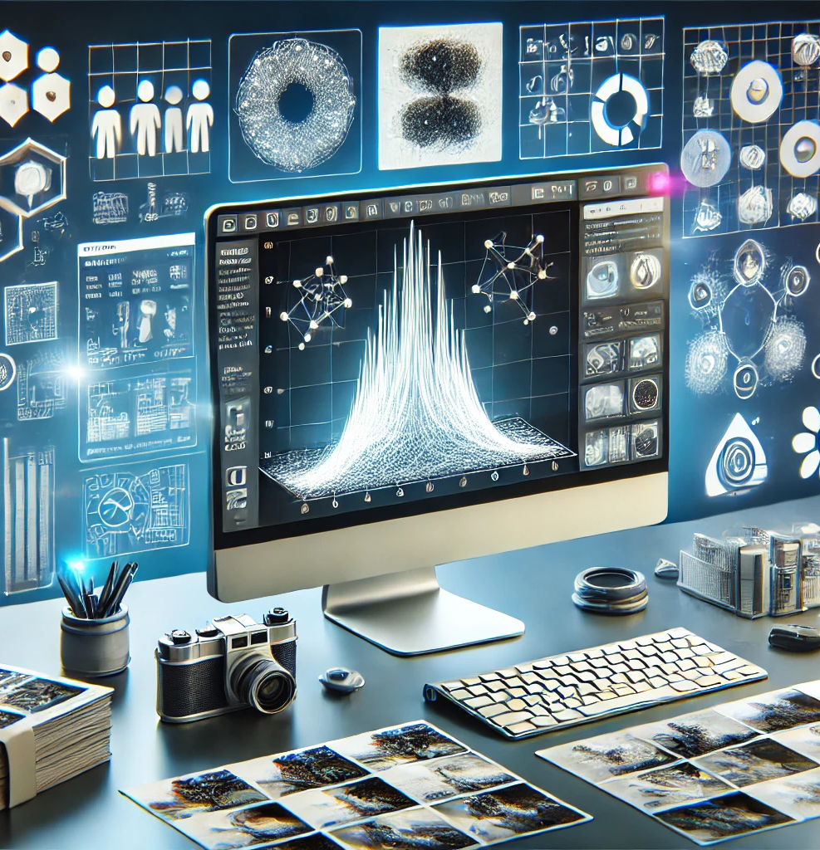
L05 Image Classification with SVM
For this assignment, I explored Support Vector Machines (SVMs) for image classification using the CIFAR-10 dataset. This was my first experience with SVM, and I deepened my understanding by researching concepts like hyperplanes, linear vs. nonlinear kernels, and the “kernel trick.” I built my lab environment from scratch and preprocessed data by converting images to grayscale, normalizing them, and splitting them into training and testing sets.

Slide 10
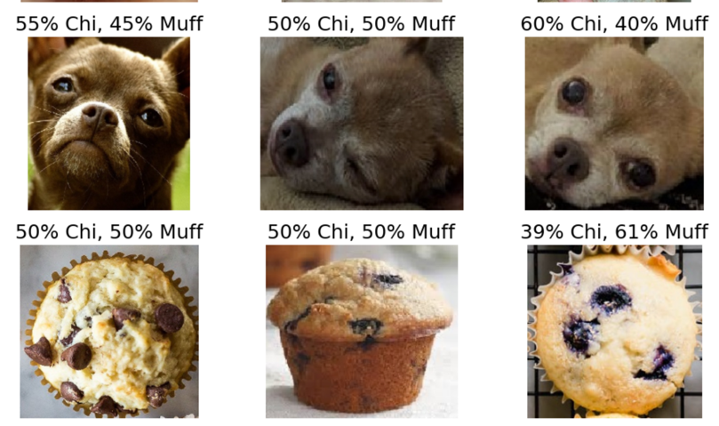
L06 Chihuahua or Muffin
For this assignment, I developed a simple neural network classifier to distinguish between images of chihuahuas and muffins. I explored key concepts like forward and backward propagation, optimization techniques, and learning rate scheduling. Through hands-on experimentation, I learned how to preprocess data by resizing and padding images to maintain aspect ratios and optimize model parameters for improved accuracy.

Slide 11
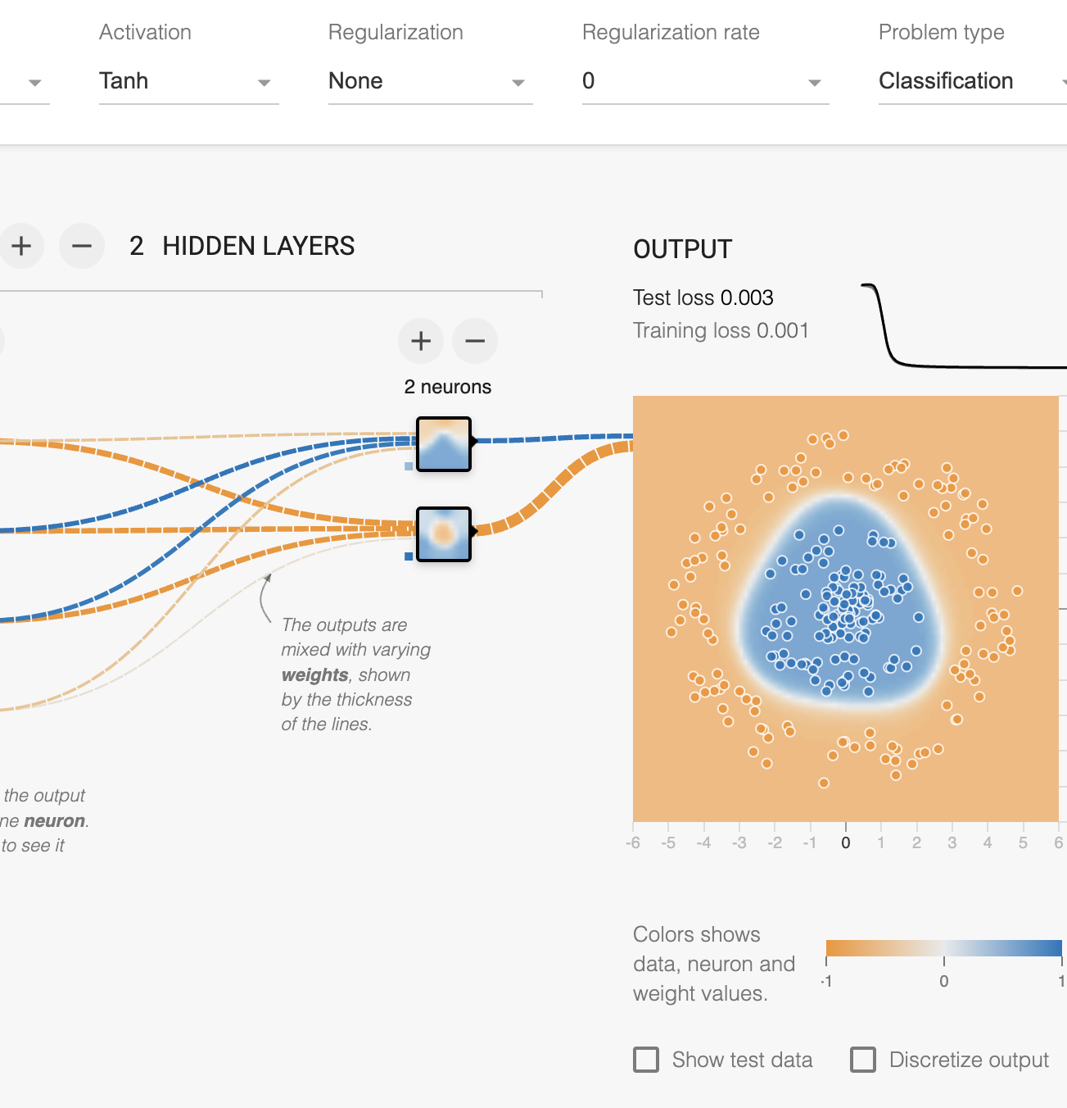
A06 TensorFlow Playground Presentation
Our team used TensorFlow Playground to gain hands-on experience with neural networks, focusing on activation functions, hidden layers, learning rates, data noise, and dataset exploration. We tested ReLU, Tanh, Sigmoid, and linear activation functions and analyzed their performance on various datasets, including the challenging spiral dataset. Adjusting neurons, layers, and learning rates highlighted how these parameters impact model accuracy and complexity.

Slide 12
A07 ITAI 1378 Manual CNN
As a team, we manually explored the concept of convolution in Convolutional Neural Networks (CNNs). Starting with two 8x8 grids representing simple images (a rectangle and a square), we designed 3x3 filters to detect vertical and horizontal edges. We created new grids highlighting detected features such as edges and corners by sliding these filters across the grids, performing element-wise multiplication, and summing the results.
6 | -2 | -2 | 0 | 0 | 2 | 2
5 | -3 | -3 | 0 | 0 | 3 | 3
4 | -3 | -3 | 0 | 0 | 3 | 3
3 | -3 | -3 | 0 | 0 | 3 | 3
2 | -3 | -3 | 0 | 0 | 3 | 3
1 | -2 | -2 | 0 | 0 | 2 | 2
0 | 1 | 2 | 3 | 4 | 5 | 6

Slide 13
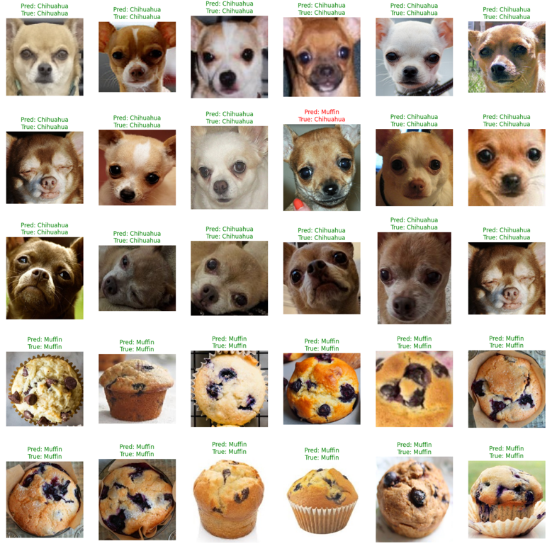
L07 Chihuahua or Muffin with CNN
In this assignment, I explored Convolutional Neural Networks (CNNs) to classify images of chihuahuas and muffins, achieving an impressive 96.88% validation accuracy after 10 epochs. Unlike traditional neural networks, CNNs preserve spatial relationships in images, making them more effective for image classification. I used layers with ReLU activation, MaxPooling, and filters to detect patterns like edges and textures, gaining a deeper understanding of CNN architecture.

Slide 14
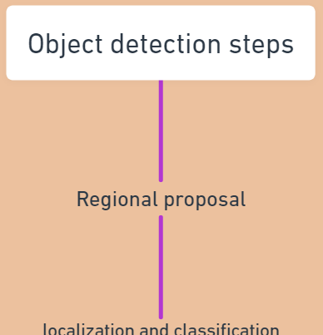
A09 ITAI 1378 CV
As a team, we developed an object detection cheat sheet to explore critical concepts, methodologies, and challenges in detecting objects within images. The assignment covered fundamental steps like regional proposals, bounding boxes, classification, and output optimization. We analyzed popular algorithms such as R-CNN, SSD, and YOLO, highlighting their strengths and applications in speed, accuracy, and real-time detection.

Slide 15
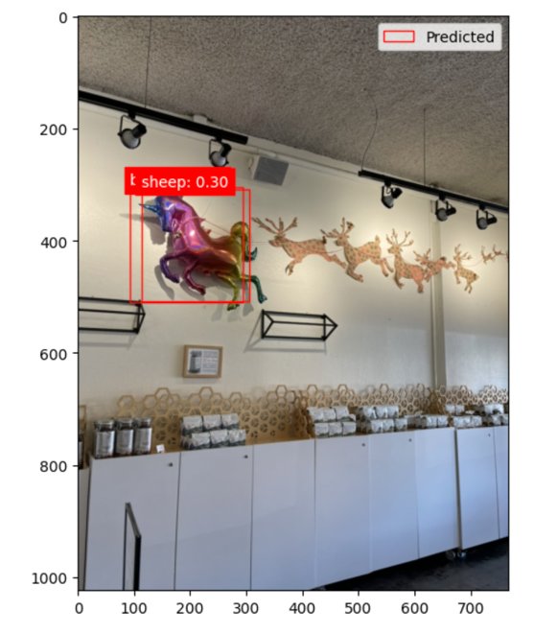
L09 Object Detection using Transfer learning and Pascal VOC 2007 Dataset
For this assignment, I explored object detection using the SSD MobileNet V2 model and the Pascal VOC 2007 dataset. Unlike image classification, object detection identifies and localizes multiple objects within an image using bounding boxes. The SSD MobileNet V2 model was chosen to balance speed and computational efficiency. Through hands-on work, I learned to filter images using specific classes, adjust confidence thresholds, and detect objects in real-world scenarios. While the model performed well on large objects, it struggled with smaller, complex, or overlapping objects.

Slide 16
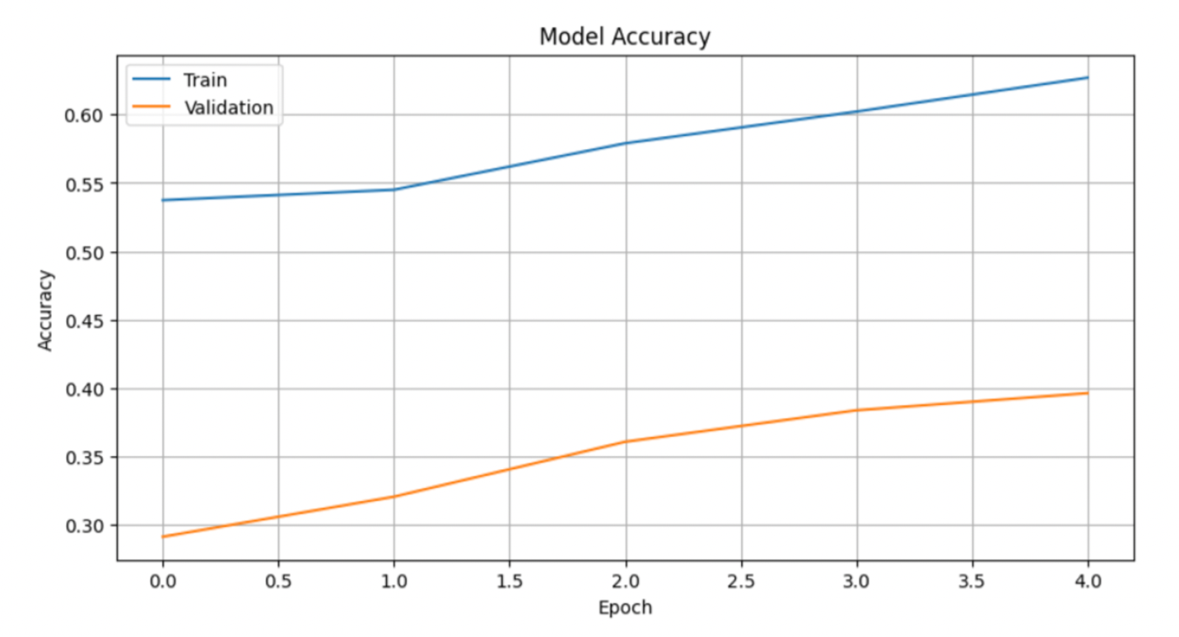
Midterm Object Detection Challenge
For my midterm project, I enhanced an object detection model using the Pascal VOC 2007 dataset after identifying limitations with CIFAR-10. I applied preprocessing techniques like resizing, augmentation, and normalization and used SSD MobileNet V2 for its speed and efficiency.
By addressing overfitting with dropout optimization and class weight adjustments, I improved training accuracy to ~60% and achieved an AUC of 78.8%. This project strengthened my skills in object detection and highlighted the importance of proper dataset selection and model tuning for real-world applications.

Slide 17
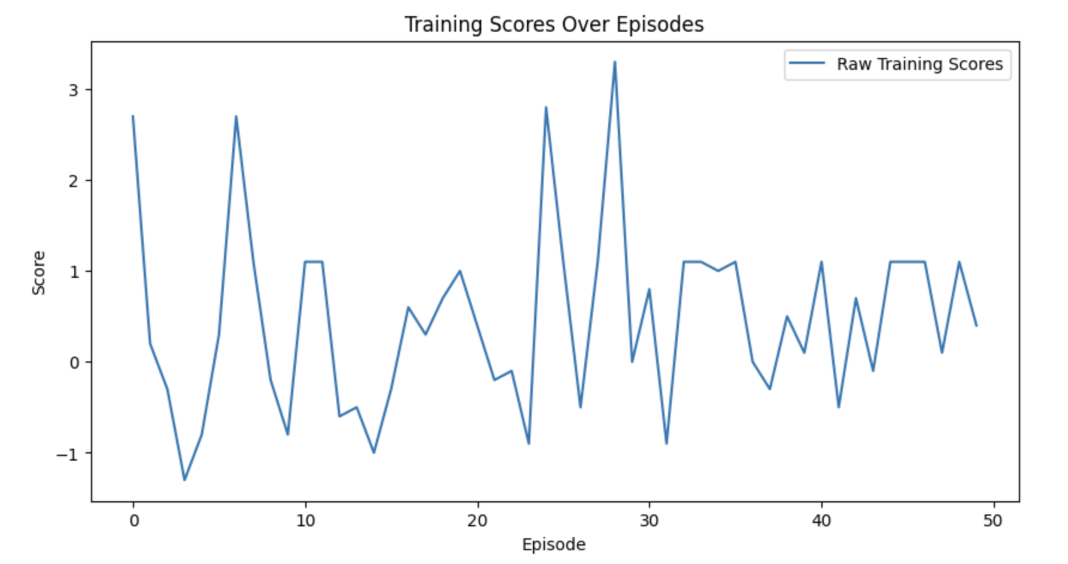
Capstone Project: Train an AI Agent to Play Flappy Bird
In my capstone project, I trained an AI agent to play Flappy Bird using reinforcement learning and computer vision techniques. The project involved setting up the environment, integrating a pre-trained MobileNet V2 model for feature extraction, and implementing Deep Q-Network (DQN) with techniques like experience replay and epsilon decay.
Challenges included achieving meaningful improvements in the agent’s performance and tuning hyperparameters. Despite limited success, with scores improving only slightly from -5.0 to -4.0 on average, I learned valuable skills in model architecture, parameter tuning, and advanced logging using tools like W&B and Optuna. This experience expanded my understanding of reinforcement learning and its practical applications.

Slide 18
Conclusion
The course enabled me to understand the basic concepts of computer vision in the rapidly evolving artificial intelligence industry. I gained practical experience with object detection, image classification, reinforcement learning, and neural networks by combining theoretical exploration with hands-on projects.
Each assignment depends on my understanding of how computer vision plays a pivotal role in real-world scenarios. I have learned valuable skills I can confidently apply daily in my work environment. I also support the idea of further exploring real-world applications.
This experience has deepened my passion for AI and computer vision, and I will continue to explore my path.

Slide 19

Thank you
Martin Demel.

Slide 20
REFERENCES
GeeksforGeeks. (2024, June 12). What is Object Detection in Computer Vision? GeeksforGeeks. https://www.geeksforgeeks.org/what-is-object-detection-in-computer-vision/
Mehta, V. (2022, January 6). Object Detection using SSD Mobilenet V2 - Vidish Mehta - Medium. Medium. https://vidishmehta204.medium.com/object-detection-using-ssd-mobilenet-v2-7ff3543d738d
GeeksforGeeks. (2022, December 6). YOLO v2 Object Detection. GeeksforGeeks. https://www.geeksforgeeks.org/yolo-v2-object-detection/
GeeksforGeeks. (2023, August 23). Faster RCNN | ML. GeeksforGeeks. https://www.geeksforgeeks.org/faster-r-cnn-ml/
Weng, L. (2017, December 31). Object Detection for Dummies Part 3: R-CNN Family. Lil’Log. https://lilianweng.github.io/posts/2017-12-31-object-recognition-part-3/
Li, X., J., Wang, S., Zhao, Y., Zhao, C., & University of California, San Diego. (2021). Object Detection using Faster R-CNN [Report]. https://noiselab.ucsd.edu/ECE228_2019/Reports/Report3.pdf
GeeksforGeeks. (2024, January 2). Handling imbalanced data for classification. GeeksforGeeks. https://www.geeksforgeeks.org/handling-imbalanced-data-for-classification/
GeeksforGeeks. (2024, July 25). Evaluating Object Detection Models: Methods and Metrics. GeeksforGeeks. https://www.geeksforgeeks.org/evaluating-object-detection-models-methods-and-metrics/
GeeksforGeeks. (2024b, July 9). Backpropagation in neural network. GeeksforGeeks. https://www.geeksforgeeks.org/backpropagation-in-neural-network/
GeeksforGeeks. (2024a, January 6). Understanding PyTorch Learning Rate scheduling. GeeksforGeeks. https://www.geeksforgeeks.org/understanding-pytorch-learning-rate-scheduling/
OpenAI. ChatGPT. Accessed October 1st, 2024. https://chat.openai.com
torch.optim — PyTorch 2.4 documentation. (2024) https://pytorch.org/docs/stable/optim.html
IBM. (2024, August 13). Support Vector Machine. IBM. https://www.ibm.com/topics/support-vector-machine
OpenAI. ChatGPT. Accessed September 26, 2024. https://chat.openai.com
GeeksforGeeks. (2024, July 4). Support Vector Machine (SVM) algorithm. GeeksforGeeks. https://www.geeksforgeeks.org/support-vector-machine-algorithm/
CIFAR-10 and CIFAR-100 datasets. (n.d.). https://www.cs.toronto.edu/~kriz/cifar.html
K, M. (2024, November 17). Cutting-Edge algorithms revolutionizing image and video analysis in 2025. Medium. https://medium.com/@maheshhkanagavell/cutting-edge-algorithms-revolutionizing-image-and-video-analysis-in-2025-14f68cfb17a2
GeeksforGeeks. (2024, June 12). What is Object Detection in Computer Vision? GeeksforGeeks. https://www.geeksforgeeks.org/what-is-object-detection-in-computer-vision/
GeeksforGeeks. (2024, September 20). CIFAR10 Image classification in TensorFlow. GeeksforGeeks. https://www.geeksforgeeks.org/cifar-10-image-classification-in-tensorflow/
GeeksforGeeks. (2022, December 6). YOLO v2 Object Detection. GeeksforGeeks. https://www.geeksforgeeks.org/yolo-v2-object-detection/
Bessi, L. (2023, July 16). #29 object detection: One stage vs two stage networks and evaluation. #29 Object detection: one stage vs two stage networks and evaluation. https://machinelearningatscale.substack.com/p/computer-vision
Bandyk, M. G., Gopireddy, D. R., Lall, C., Balaji, K., & Dolz, J. (2021). MRI and CT bladder segmentation from classical to deep learning based approaches: Current limitations and lessons. Computers in Biology and Medicine, 134, 104472. https://doi.org/10.1016/j.compbiomed.2021.104472
Li, J., Jiang, P., An, Q., Wang, G., & Kong, H. (2023). Medical image identification methods: A review. Computers in Biology and Medicine, 169, 107777. https://doi.org/10.1016/j.compbiomed.2023.107777
Abbasi, M., Shahraki, A., & Taherkordi, A. (2021). Deep Learning for Network Traffic Monitoring and Analysis (NTMA): a survey. Computer Communications, 170, 19–41. https://doi.org/10.1016/j.comcom.2021.01.021
Maniriho, P., Mahmood, A. N., & Chowdhury, M. J. M. (2021). A study on malicious software behaviour analysis and detection techniques: Taxonomy, current trends and challenges. Future Generation Computer Systems, 130, 1–18. https://doi.org/10.1016/j.future.2021.11.030
Patel, N. (2024, August 13). The role of AI in healthcare. Forbes. https://www.forbes.com/councils/forbestechcouncil/2024/01/18/the-role-of-ai-in-healthcare/

